Slide 1
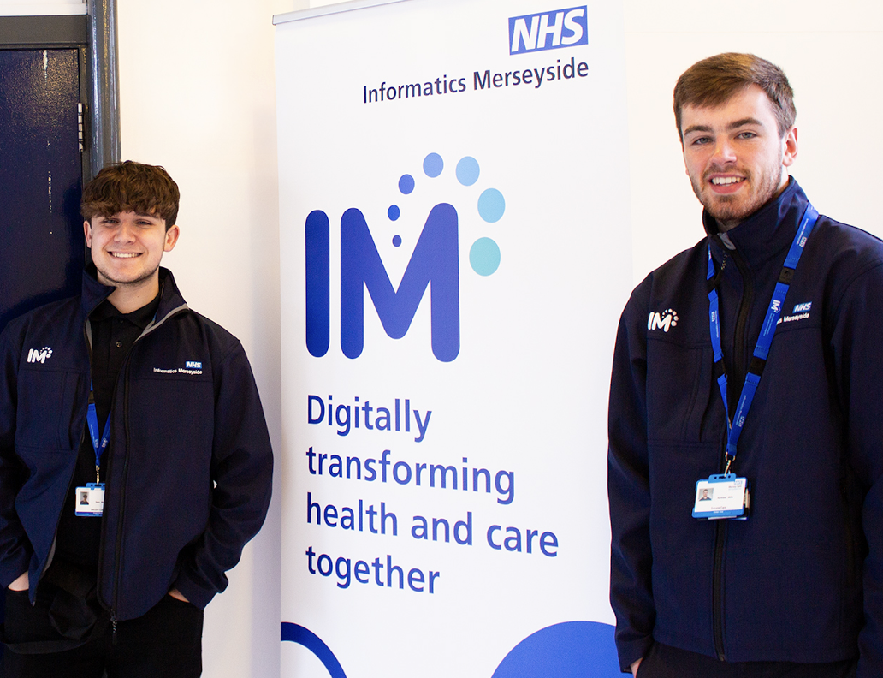
IT Support Changes from
1 October 2026
From 1 October 2026, digital support
for ICB corporate and Primary Care
colleagues in Cheshire East,
Cheshire West, Warrington and
Wirral, and for ICB corporate
colleagues in Halton, will be provided
by NHS Informatics Merseyside (IM).

Slide 2
What's changing and why?
From 1 October 2026, digital support for ICB corporate and Primary Care colleagues in Cheshire East, Cheshire West, Warrington and Wirral, and for ICB corporate colleagues in Halton, will be provided by NHS Informatics Merseyside (IM).
This change follows the planned national closure of Commissioning Support Units (CSUs), requiring new arrangements to ensure the continued delivery of the digital services currently provided by Midlands and Lancashire CSU across Cheshire and Merseyside. The transition has been carefully planned, with partner organisations working collaboratively to maintain service continuity and minimise disruption.
To support these arrangements and retain valuable knowledge, skills and experience, some MLCSU colleagues currently delivering these digital services will transfer to IM, helping to ensure a seamless continuation of support.
There will be no change to the digital services provided following the transfer of digital service provision from MLCSU to IM and colleagues will continue accessing digital services such as training, Smartcard services and clinical system support. However, as a result of the transfer of digital services to IM, there will be a change to the IT Service Desk telephone number and the digital portal used to report IT issues and access support.

Slide 3

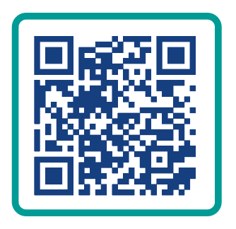

Accessing IT support from 1 October 2026
Urgent IT Issues
From 1 October 2026,
for issues affecting patient care, multiple users or if you are unable to access the
IM Digital Portal, please call your IM IT Service Desk.
From 1 October 2026, the quickest and easiest way to access IT support is
through your IM Digital Portal.
To log and track your IT support
requests, scan the QR code or go to:
https://digitalportal.imerseyside.nhs.uk/
0151 296 7777
The IM Digital Portal
will be available from
1 October 2026.
You will not need any new login details.
Your IM Digital Portal will also be accessible from an icon on your home screen.

Slide 4
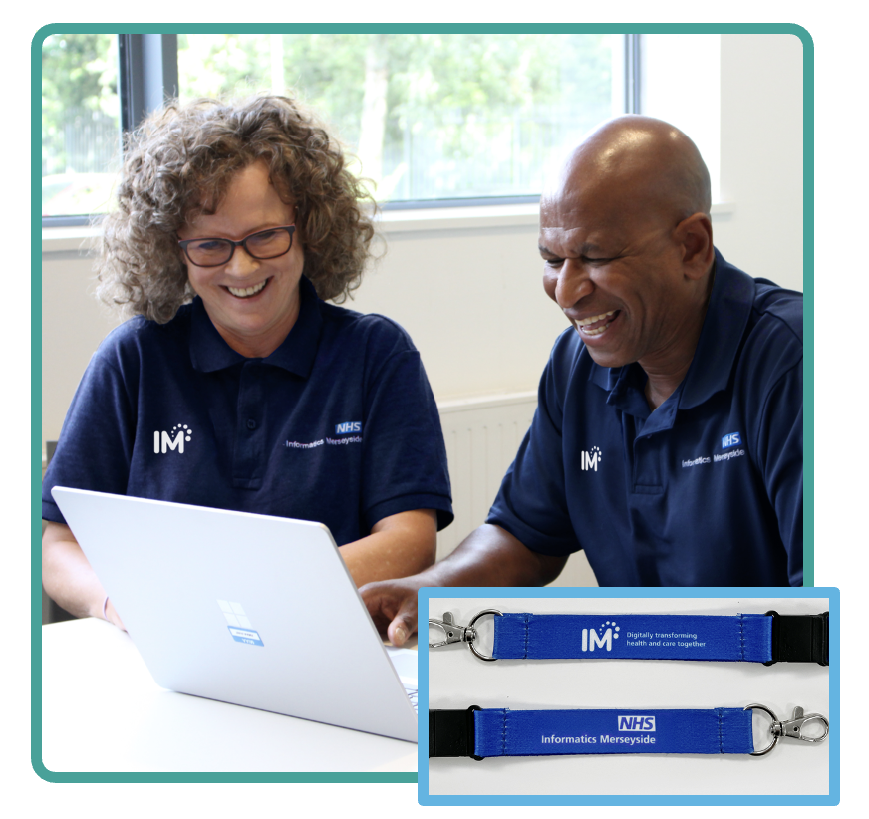
On site digital support will still be available
On-site digital support will continue to be provided for IT issues that cannot be resolved through the IM IT Service Desk and require a site visit.
Please be aware that you may
see digital colleagues wearing
IM-branded workwear and lanyards when visiting your site.

Slide 5
Further information
For further information about the planned changes to IT support services from 1 October 2026, please visit:
https://imerseyside.nhs.uk/service-changes
If you have any questions about these service changes, please get in touch.
We thank you in advance for your understanding and support.

